Slide 1
FIFA World Cup Analysis
- By Akshay p p

Slide 2
Introduction
The FIFA World Cup is a global football competition contested by the various football-playing nations of the world.
It is contested every four years and is the most prestigious and important trophy in the sport of football
The World Cups dataset shows all information about all the World Cups in history, while the World Cup Matches dataset shows all the results from the matches contested as part of the cups

Slide 3
Data
WorldcupMatches dataset
Year: The year the match took place.
Datetime: The date and time of the match.
Stage: The stage of the tournament (e.g., Group Stage, Quarter-finals) .
Stadium: The name of the stadium where the match was played.
City: The city where the match took place.
Home Team Name: The name of the home team.
Home Team Goals: The number of goals scored by the home team.
Away Team Name: The name of the away team.
Away Team Goals: The number of goals scored by the away team.
Win conditions: Conditions under which the win was achieved (e.g., extra time, penalties).
Attendance: The number of spectators attending the match.
Half-time Home Goals: The number of goals scored by the home team by half-time.
Half-time Away Goals: The number of goals scored by the away team by half-time.
Referee: The name of the referee officiating the match.
Assistant 1: The name of the first assistant referee.
Assistant 2: The name of the second assistant referee.
RoundID: An identifier for the round of the tournament.
MatchID: An identifier for the match.
Home Team Initials: The initials of the home team.
Away Team Initials: The initials of the away team.

Slide 4
Data
WorldCup Players
RoundID: An identifier for the round of the tournament.
MatchID: An identifier for the match.
Team Initials: The initials of the team.
Coach Name: The name of the team's coach.
Line-up: Indicates if the player was in the starting line-up (S).
Shirt Number: The player's shirt number.
Player Name: The name of the player.
Position: The player's position on the field.
Event: Key events involving the player (e.g., goals, yellow cards).
WorldCups
Year: The year the World Cup was held.
Country: The host country of the World Cup.
Winner: The team that won the World Cup.
Runners-Up: The team that finished in second place.
Third: The team that finished in third place.
Fourth: The team that finished in fourth place.
GoalsScored: The total number of goals scored in the tournament.
QualifiedTeams: The number of teams that qualified for the tournament.
MatchesPlayed: The total number of matches played in the tournament.
Attendance: The total attendance across all matches in the tournament.

Slide 5
KPI
Goals – Total Goal scored in the entire world cup.
Matches – Total Number of Matches.
Attendance –Total attendance of people participated

Slide 6
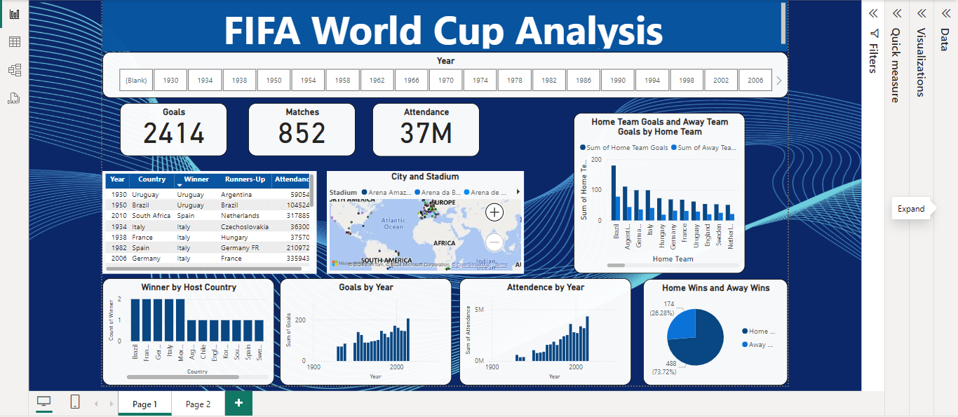

Slide 7
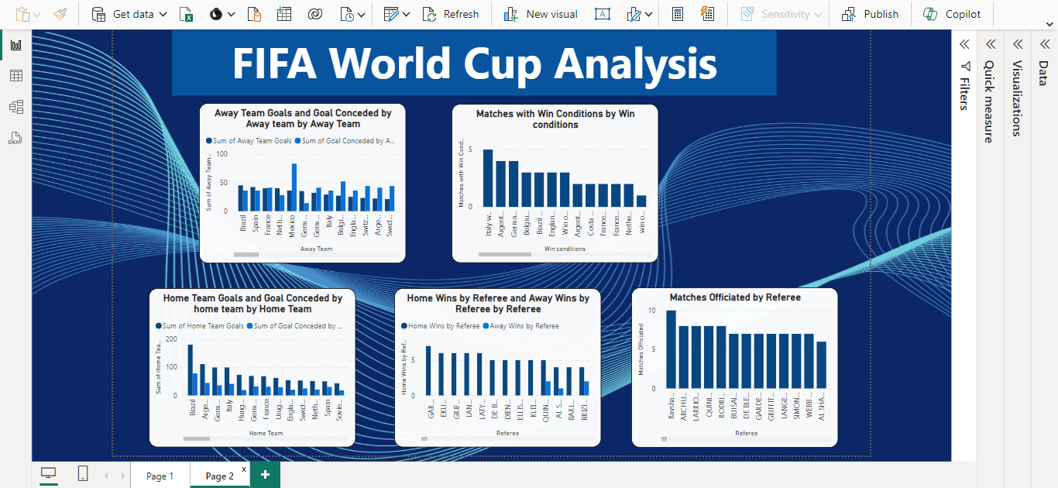

Slide 8
Thank you

